Slide 1
Web Survey System
Drop Table team;

Slide 2


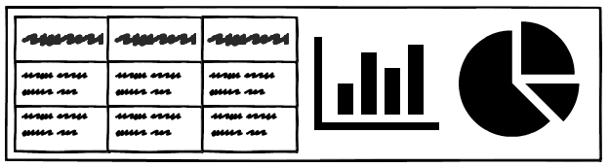
Project Definition
Web-based survey system
Can be implemented on any website
Customizable questions and email script
Generates insightful reports from responses

Slide 3
What makes it unique?
Semantic Differential Questions (w/ Likert Scale)
Survey Structure Targets Companies of Any Size
Left Statement (Positive) |  |  |  | Right Statement (Negative)
 | Strongly Agree | Mostly Agree | Partly Agree | Partly Agree | Mostly Agree | Strongly Agree
CSC 490 is great! | • | ◦ | ◦ | ◦ | ◦ | ◦ | CSC 490 is awful!
 | 1 ➡ ∞ |  | 1 ➡ ∞ |  | 1 ➡ ∞
Company |  | Survey |  | Department |  | Participant

Slide 4

Requirement Specification
Administrative
Administrator must log in to access admin page.
Administrator should be able to manage (create, update, delete):
Companies
Surveys
Departments
Participants
Questions

Slide 5
Requirement Specification
Administrative
Administrator should create new surveys with the below process:
Create a company record or choose an existing one.
Create a list of departments involved in the survey.
Supply a comma delimited list of emails for each department.
Choose the questions involved in the survey.
Automatic emails should be sent out to each survey participant.
Administrator should be able to send out reminder emails to:
All participants in the company who have not completed the survey.
All participants in a department who have not completed the survey.
An individual participant who has no completed the survey.
Administrator should be able to generate Excel reports.
Overall survey results and breakdown by department.

Slide 6

Requirement Specification
Survey
Participant should receive email with link to survey page.
Hyperlink should contain a unique ID.
Survey page should not be accessible with an invalid ID.
Survey questions should be semantic differential.
Response choices should be Likert scale.
Participant must complete all questions before submitting.
The participant should be prompted for confirmation.
If any questions remain incomplete, the earliest incomplete question should be shown (scroll to location).
Participant should only be able to submit the survey once.
Survey page should be inaccessibly with the same ID.
Responses should be recorded anonymously.

Slide 7

Requirement Specification
Database
The database should be implemented using MySQL
Relational database
Free and open-source
The schema should be efficiently designed
Relationships used to eliminate redundant data
Appropriate data types and length restrictions.

Slide 8
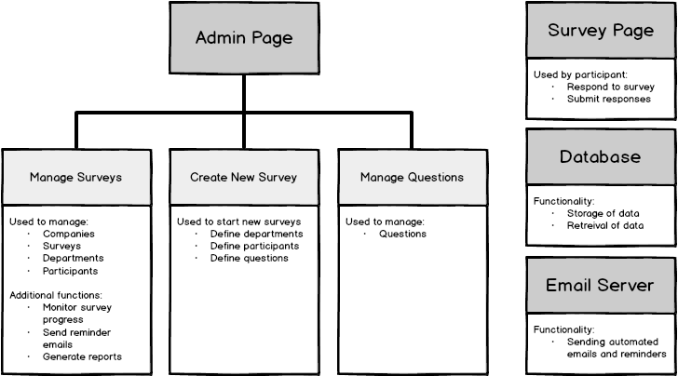
Subsystems

Slide 9
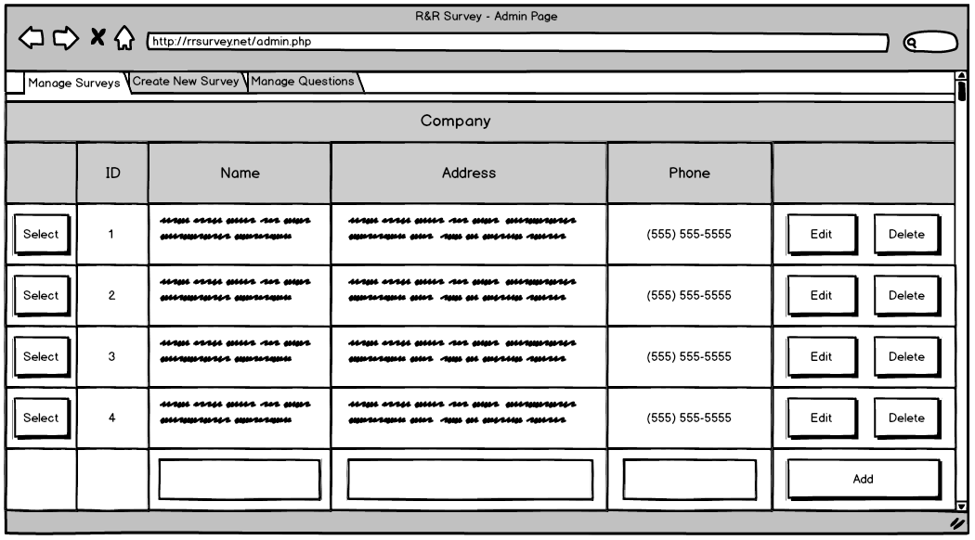
Mockup Walkthrough

Slide 10
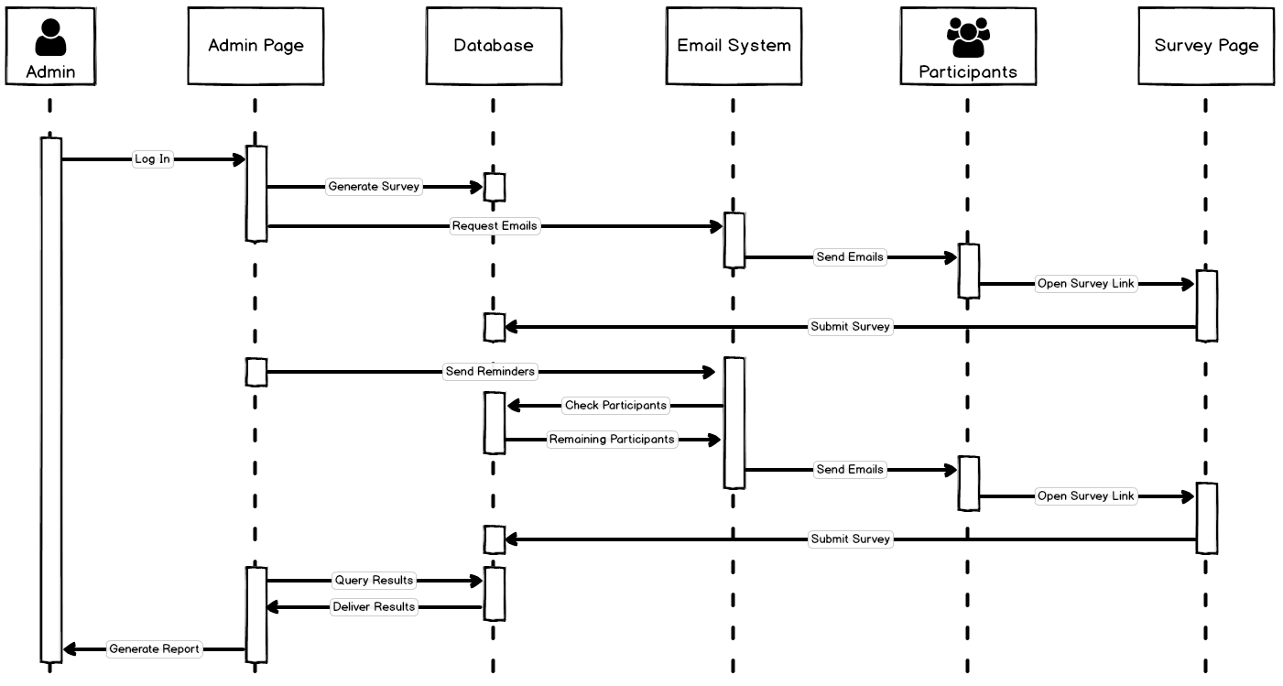
System Model Sequence Diagram

Slide 11
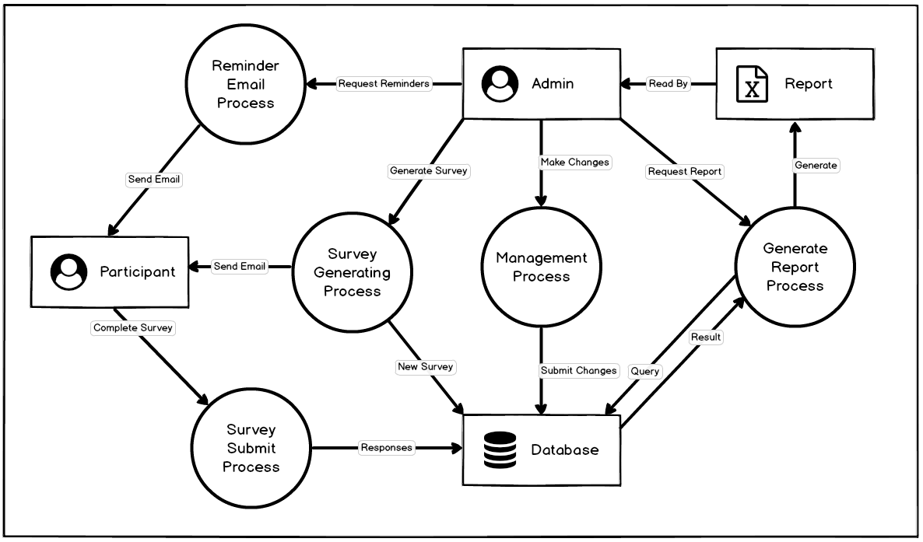
System Model Data Flow Diagram

Slide 12
Algorithm Analysis
Database Operations:
INSERT New Record – O(1)
UPDATE Record – O(log(n)) w/ Indexing
DELETE Record – O(log(n)) w/ Indexing
SELECT Single Record – O(log(n)) w/ Indexing
SELECT All Records – O(n)
System Operations:
Create New Survey – O(n)
Submit Survey Responses – O(n)
Send Reminder Email – O(1)
Send Reminder Emails (survey, department) – O(n)
Generate Report – O(n)

Slide 13
Database Schema
Company
ID (SMALLINT) – Auto Increment ID
Name (VARCHAR) – Name of the company
Address (VARCHAR) – Address of the company
Phone (VARCHAR) – Phone number of contact
Survey
ID (INT) – Auto Increment ID
CID (SMALLINT) – Company ID (one company, many surveys)
StartDate (DATE) – The start date for the survey
EndDate (DATE) – The end date for the survey

Slide 14
Database Schema
Department
ID (INT) – Auto Increment ID
SID (INT) – Survey ID (one survey, many departments)
Name (VARCHAR) – Name of the company
Participant
ID (INT) – Auto Increment ID
DID (INT) – Department ID (one department, many participants)
Email (VARCHAR) – The participant’s email
Submitted (TINYINT) – Indicated submission status (boolean)

Slide 15
Database Schema
Question
ID (SMALLINT) – Configurable Question ID
LS (VARCHAR) – Left statement
RS (VARCHAR) – Right statement
SurveyQuestion (XREF Table)
SID (INT) – Survey ID (one survey, many question choices)
QID (INT) – Question ID (one question, many times chosen)
Order (SMALLINT) – The order of the question in the survey
Response
ID (INT) – Auto Increment ID
DID (INT) – Department ID (one department, many responses)
QID (SMALLINT) – Question ID (one question, many responses)
Response (TINYINT) – Participant response (1-6)

Slide 16
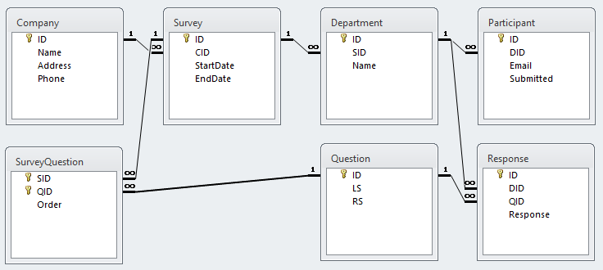
Database ER Diagram
Relationships maintain cascading:
ON UPDATE CASCADE – If parent primary key is changed, child foreign key automatically changes to reflect that.
ON DELETE CASCADE – If parent record is deleted, all child records are also deleted.

